Slide 1

ЖИДКОСТИ В УСЛОВИЯХ НАНОКНФАЙНМЕНТА: МИКРОСКОПИЧЕСКИЕ СВОЙСТВА И ФАЗОВЫЕ ПЕРЕХОДЫ
В. Н. Рыжов, Д.Е. Дудалов, Ю.Д. Фомин, Е.Н. Циок
Институт физики высоких давлений им. Л.Ф. Верещагина РАН

Slide 2
Мотивация и Содержание
Влияние конфайнмента на структуру и термодинамические свойства жидкостей
Зависимость сценария плавления в 2D от формы потенциала
Влияние случайного пиннинга на сценарий плавления в 2D
Примеры систем с наноконфайнментом: коллоиды и вода
Водоподобные аномалии и потенциалы с отрицательной кривизной
Сценарии плавления в 2D
Влияние случайного пиннинга на сценарии плавления

Slide 3
Примеры наносистем
Изучение конденсированных систем в условиях конфайнмента обусловлено тем фактом, что в случае близости радиуса межмолекулярного взаимодействия и характерной длины корреляции с пространственным масштабом конфайнмента в системе могут возникать структуры и проявляться динамические свойства, которые не наблюдаются в объемных образцах.

Slide 4
Примеры наносистем
Углеродные нано трубки

Slide 5
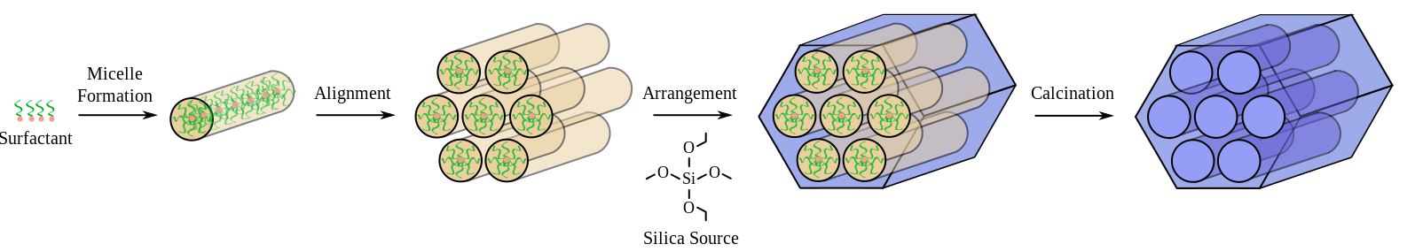
Примеры наносистем
Гексагональные поры «мобильного кристаллического материала 41 (МСМ 41)» J. Phys. Chem. 100, 1985 (1996).

Slide 6
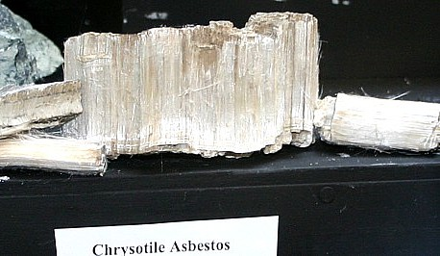
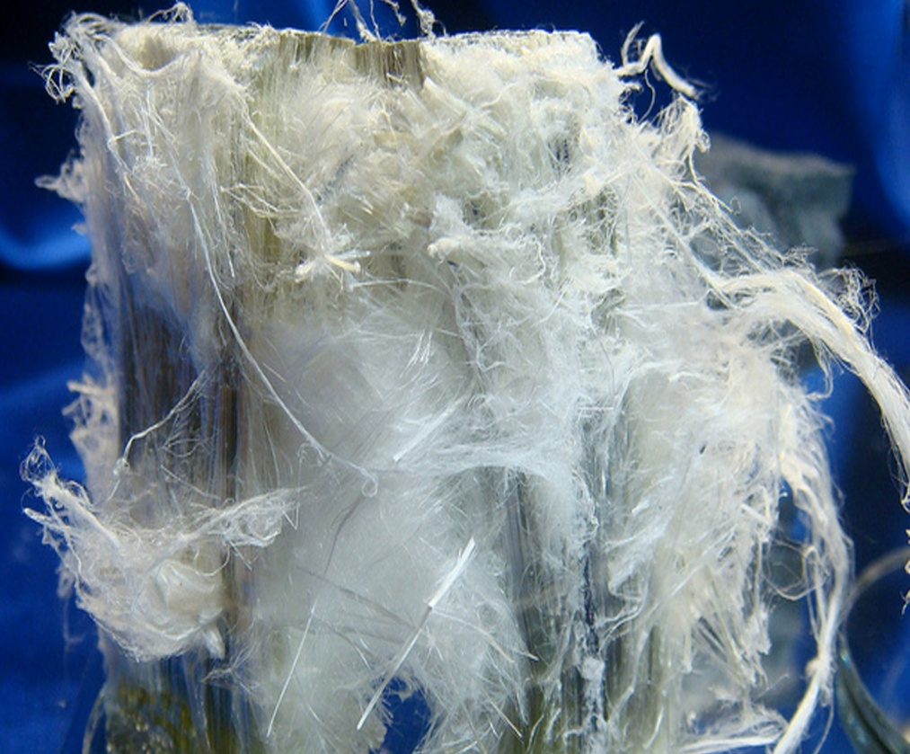
Lizardite Asbestos
Fibrous hydrophilic material
Fibers are characterised by flexibility, high-tensile strength, incombustibility, resistance to acids and bases, large surface area and abrasion resistance
Notes:
6

Slide 7
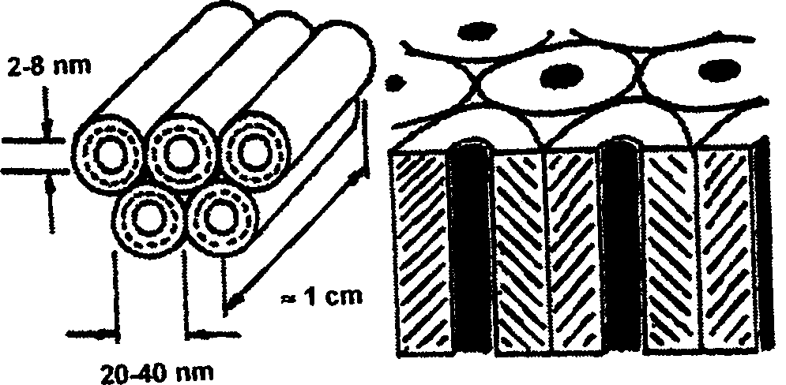
Confined Water: asbestos
Inner diameter: 2-8 nm
Outer diameter: 20-40 nm
Water inside asbestos tubes:
E. Mamontov, Yu. A. Kumzerov, and S. B. Vakhrushev, Phys. Rev. E 71, 061502 (2005)
Notes:
7

Slide 8
Неоднородное распределение – твердые сферы и система с потенциалом Леннарда-Джонса в нанощели с твердыми стенками (Microfluidics and Nanofluidics 10, 899 (2011))

Slide 9
Cyclohexane Confined in Slit Carbon Nanopore (Yu. D. Fomin, E.N. Tsiok and V.N. Ryzhov, arXiv: 1508.0395)

Slide 10
Cyclohexane Confined in Slit Carbon Nanopore (Yu. D. Fomin, E.N. Tsiok and V.N. Ryzhov, arXiv: 1508.0395)
H = 25.355°A
H = 33.355°A

Slide 11
Benzene in carbon nanotube (Y.D. Fomin, E.N. Tsiok, V.N. Ryzhov, Journal of Computational Chemistry 2015, DOI: 10.1002/jcc.23872).

Slide 12
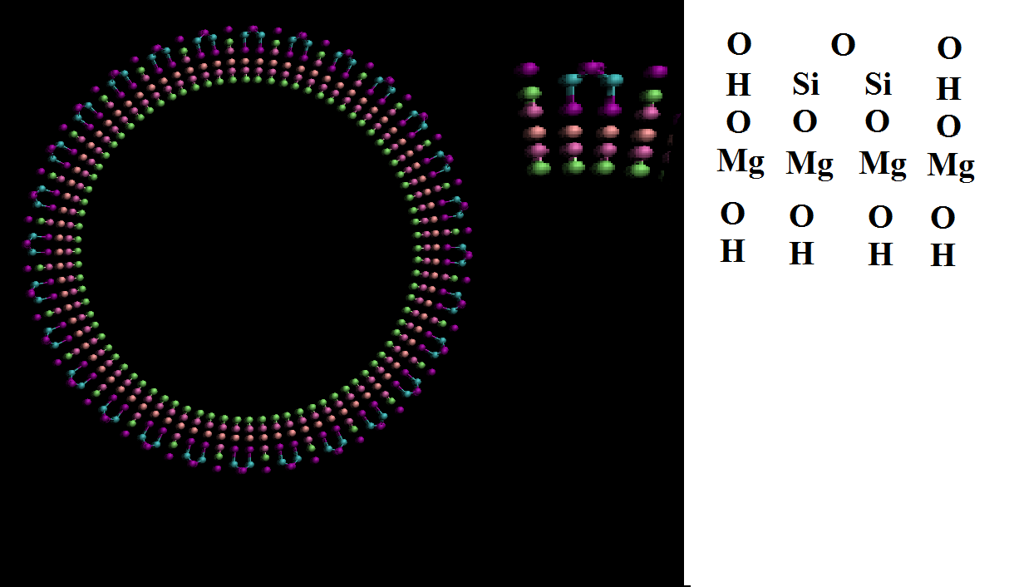
Lizardite Asbestos Tube
Internal radius: 17.85 A
External radius: 23.05 A
Tube length: 53.168 A
Notes:
12

Slide 13
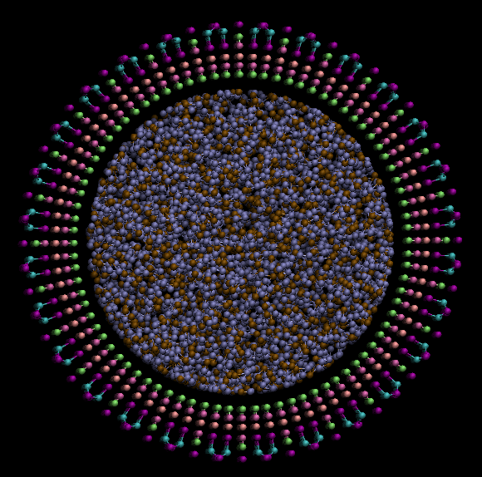
Water in the Lizardite Asbestos Tube
Lizardite Asbestos Tube:
1800 water molecules
Initial structure is constructed by Packmol program [1]
SPC/E water model
Molecular Dynamics
Clay Force Field [2]
T=300 – 1000 K
1 ns for equilibration
0.5 ns for production
[1] L. Martínez, et. Al. J. Comp. Chem. 30(13):2157-2164, 2009
[2] R. T. Cygan et. Al. J. Phys. Chem. B 108, 1255-1266 (2004)
Notes:
13

Slide 14
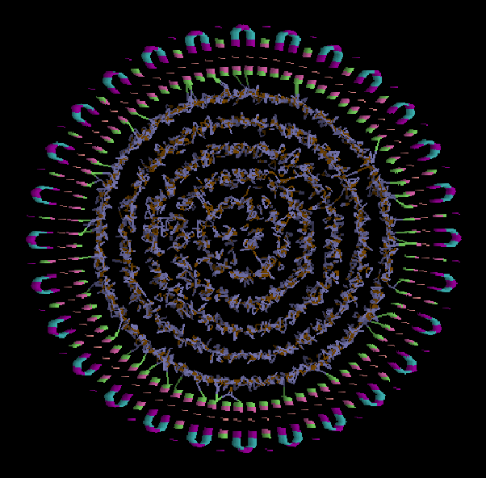
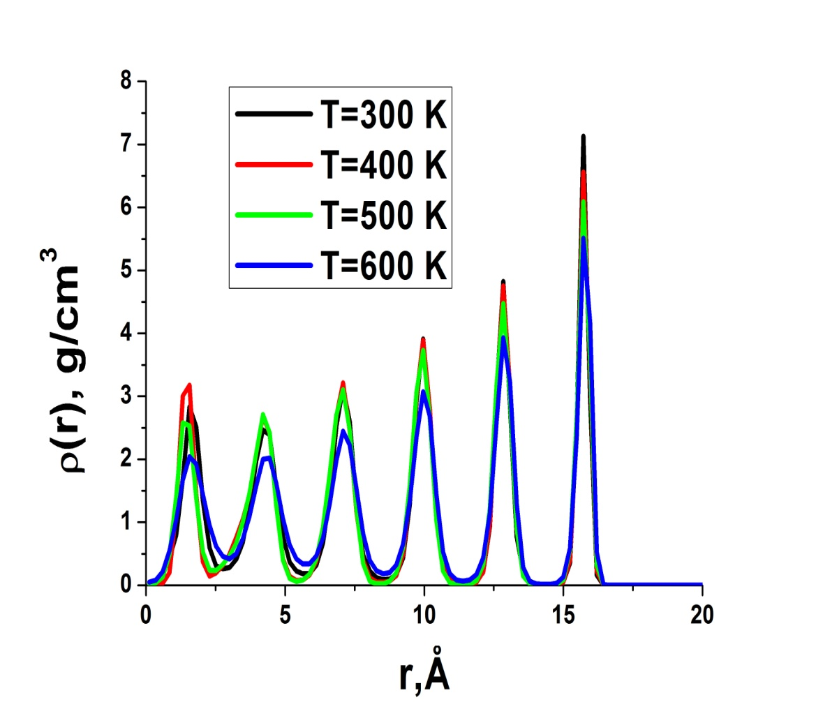
Water in the Lizardite Asbestos Tube: Low Temperature
Density profiles of water oxygens:
T=500 K
Notes:
14

Slide 15
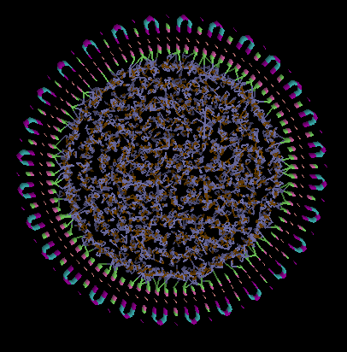
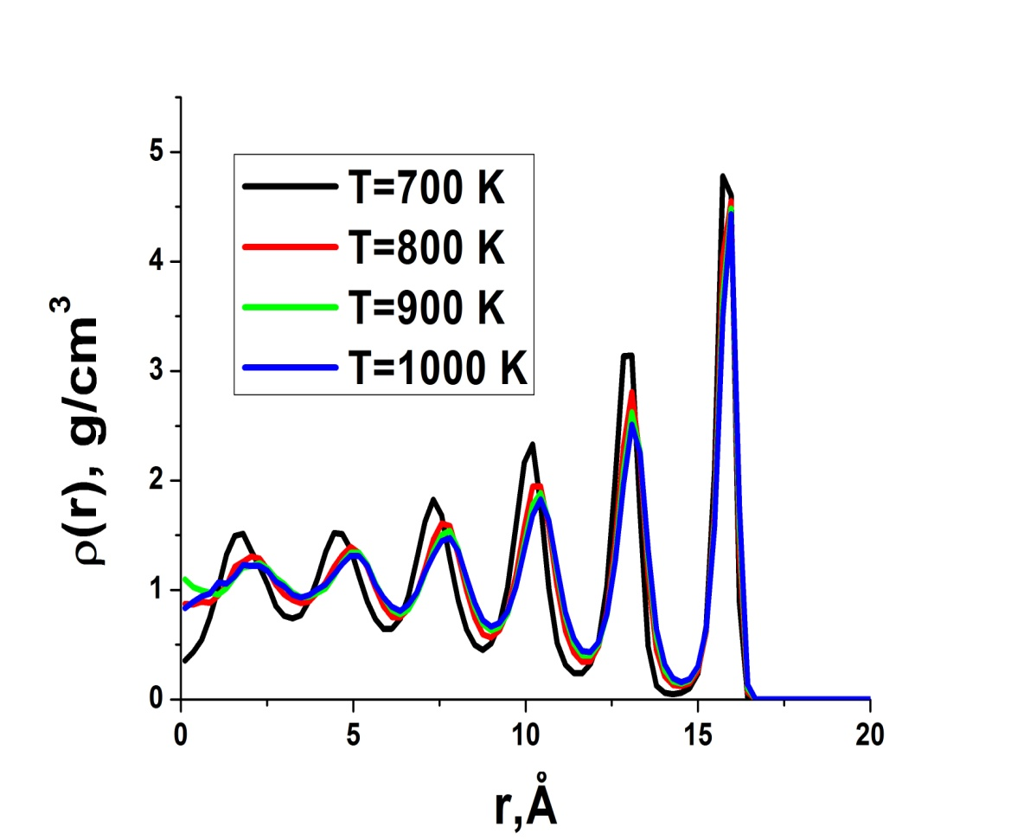
Water in the Lizardite Asbestos Tube: High Temperature
Density profiles of water oxygens:
T=1000 K
Notes:
15

Slide 16
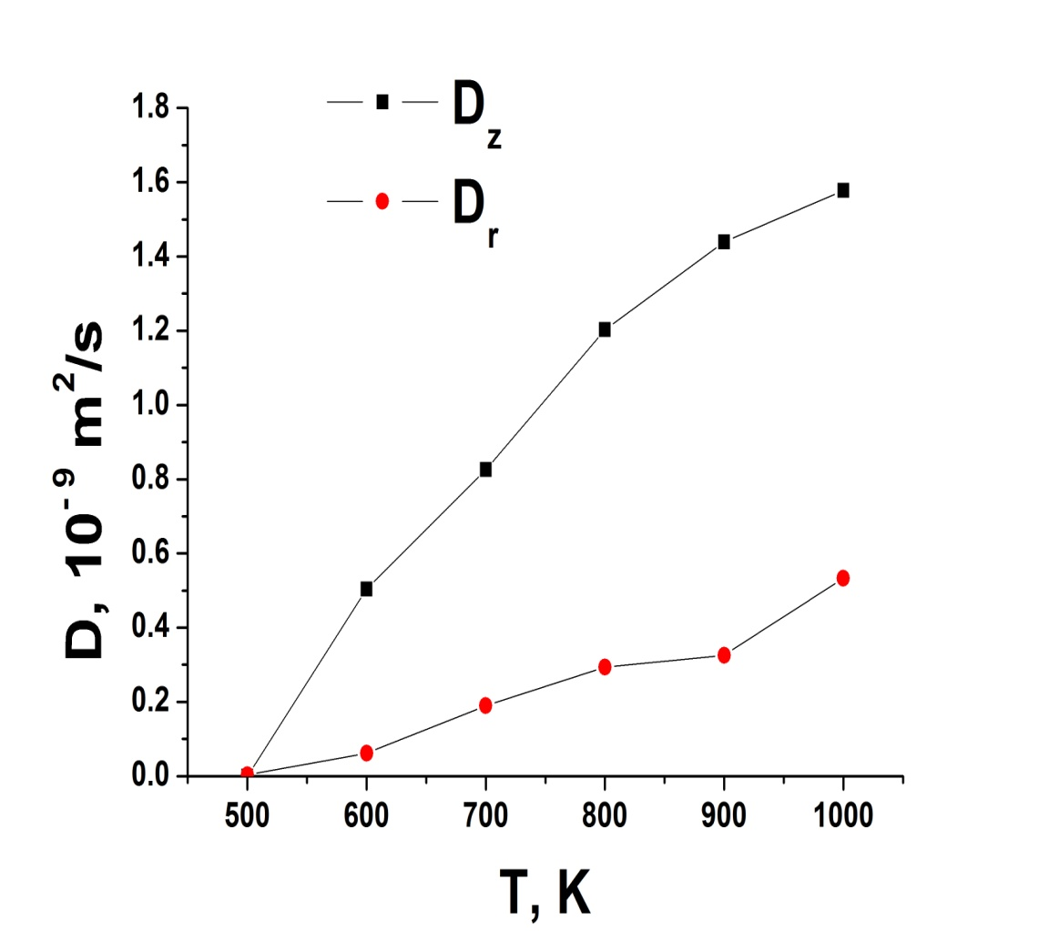
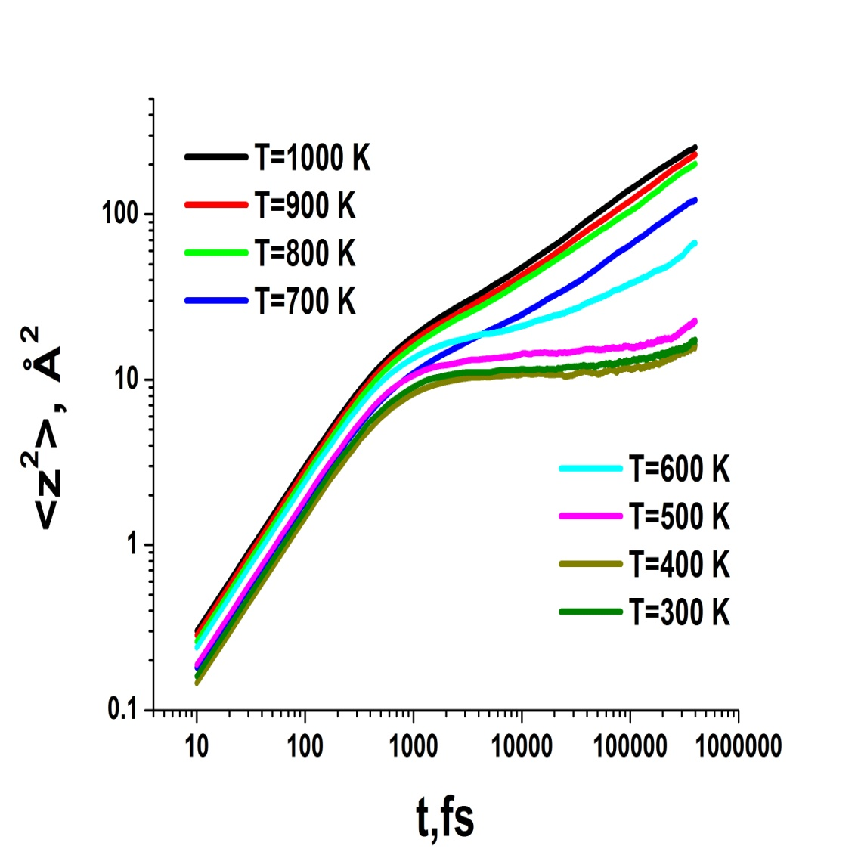
Water in the Lizardite Asbestos Tube: Diffusion
Diffusion coefficients
Mean square displacement along the tube axis
Bulk SPC/E at T=600 K
Notes:
16

Slide 17
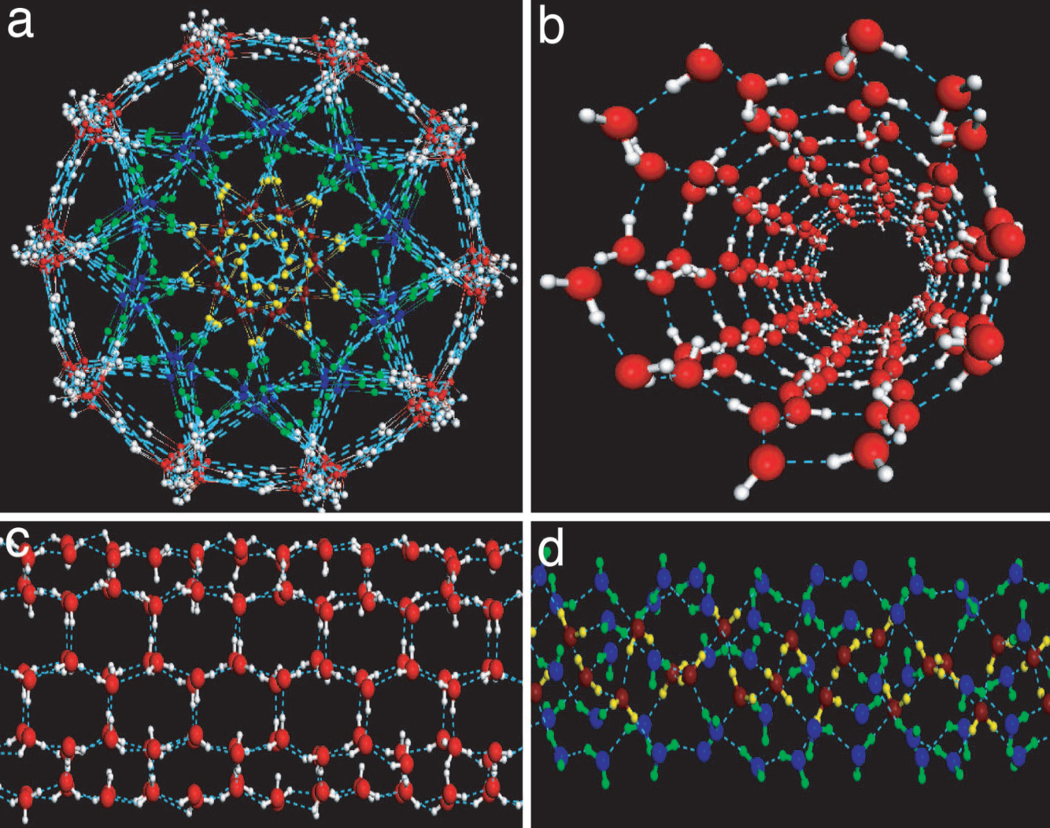
Confined Water: carbon nanotubes
Numerous different ordered phases of ice in different carbon nanotubes
Formation of ice in
(24,0) carbon nanotube. Axial pressure is 800 MPa.
Jaeil Bai, Jun Wang, and X. C. Zeng, PNAS 103, 19664 (2006)
Notes:
17

Slide 18
Confined Water: carbon nanotubes (K. Koga et al, Nature 412, 802 (2001))
(a,d) 11.1 nm, (b,e) 11.9 nm, and (c,f) 12.6 nm inner diameter SWCNTs

Slide 19
Computer simulations and experimental study of water in slit pores
Confinement can modify the dynamics, the thermodynamics and the structural properties of liquids, including water, when the range of molecular interaction and the length scale associated with position correlations in a system are similar to the length scale of confinement .
Simulation results for the TIP5P model of water in a quasi-two-dimensional hydrophobic slit nanopore (Sungho Han, M. Y. Choi, Pradeep Kumar and H. Eugene Stanley, NATURE PHYSICS 6, 685 (2010))

Slide 20
Computer simulations and experimental study of water in slit pores
The phase diagram of two layers of (TIP4P and mW) water confined between parallel non hydrogen bonding walls (Jessica C. Johnston, Noah Kastelowitz, and Valeria Molinero, THE JOURNAL OF CHEMICAL PHYSICS 133, 154516 (2010)).

Slide 21
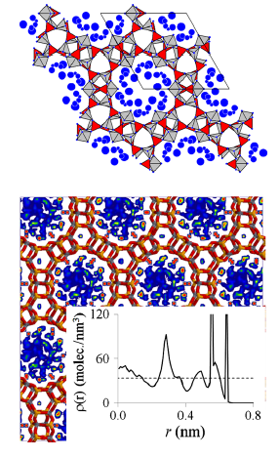
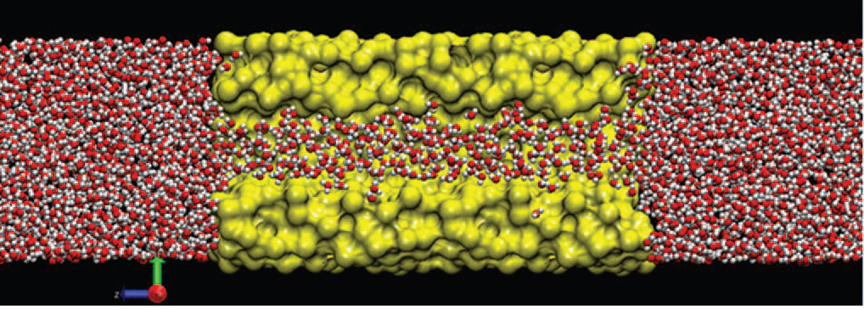
Confined Water: hydrophilic confinement
R. Renou et al. J. Chem. Phys. 140, 044704 (2014)
Usually in hydrophobic confinement ordered structures are formed while in hydrophilic one glass transition takes place
F. G. Alabarse et al. Phys. Rev. Lett. 109, 035701 (2012)
Notes:
21

Slide 22
Computer simulations and experimental study of water in slit pores
The structure, dynamics, and transport properties of nano-confined (SPC/E) water between parallel graphite plates (Hamid Mosaddeghi, Saman Alavi, M. H. Kowsari, and Bijan Najafi, THE JOURNAL OF CHEMICAL PHYSICS 137, 184703 (2012))
(a) The water layers adjacent to the graphite wall in the H = 7 Å
simulation. (b) A view of equilibrated water layer without graphite walls showing the hexagonal arrangement of water molecules; (c) The geometric structure of 12 selected water molecules arranged in hexagonal structures.

Slide 23
Computer simulations and experimental study of water in slit pores
The nanoconfined between two graphene sheets water at room temperature forms ‘square ice’- a phase having symmetry qualitatively different from the conventional tetrahedral geometry of hydrogen bonding between water molecules. Square ice has a high packing density with a lattice constant of 2.83A˚ and can assemble in bilayer and trilayer crystallites (G. Algara-Siller, O. Lehtinen, F. C. Wang, R. R. Nair, U. Kaiser, H. A.Wu, A. K. Geim & I. V. Grigorieva, NATURE 519, 443 (2015)).

Slide 24
Effective potential for water (O.Mishima and H.E. Stanley, Nature 396, 329 (1998))
Traditional MD computer water models (ST2,SPC,TIP3P,TIP4P,TIP5P)
replace 3 nuclei and 18 electrons interacting via quantum mechanics by a few point charges and 3 point masses interacting via classical mechanics
Why not to do further simplifications?

Slide 25
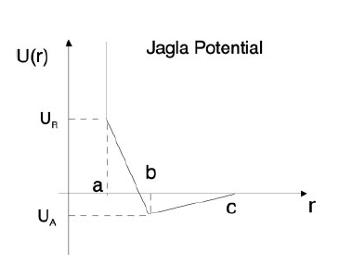


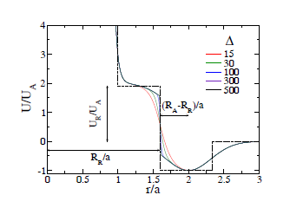
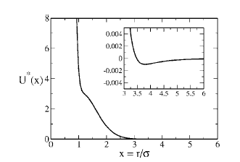
Spherically symmetric two-scale potentials
E. A. Jagla, J. Chem. Phys. 111, 8980 (1999); E. A.
Jagla, Phys. Rev. E 63, 061501 (2001).
A. B. de Oliveira, P. A. Netz, T. Colla, and M. C. Barbosa, J. Chem. Phys. 124, 084505 (2006).
G. Franzese, J. Mol. Liq. 136, 267 2007; Pol Vilaseca and Giancarlo Franzese, J. Chem. Phys., 133, 084507 (2010).

Slide 26
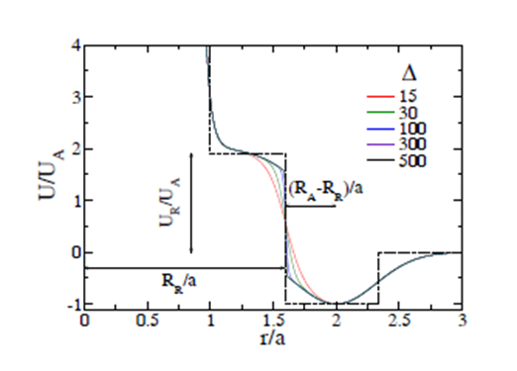
Core-softened potential systems in slit pores
F. Leonia and G. Franzese, J.Chem.Phys.
141, 174501 (2014)
L. B. Krott, J. R. Bordin, and M.C. Barbosa, J. Phys. Chem. B 2015, 119, 291−300

Slide 27


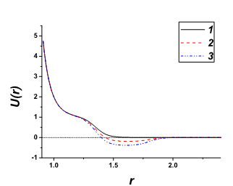
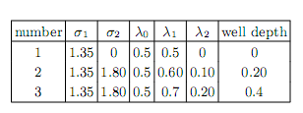
Smooth Repulsive Shoulder Potentials (Yu. D. Fomin, N.V. Gribova, V.N.Ryzhov, S.M. Stishov, and Daan Frenkel, J. Chem. Phys. 129, 064512 (2008); Yu.D. Fomin, V.N. Ryzhov, and E.N. Tsiok, J. Chem. Phys. 134, 044523 (2011)).
Smooth Repulsive Shoulder System (SRSS)
Smooth Repulsive Shoulder System With Attractive Well (SRSS-AW)

Slide 28
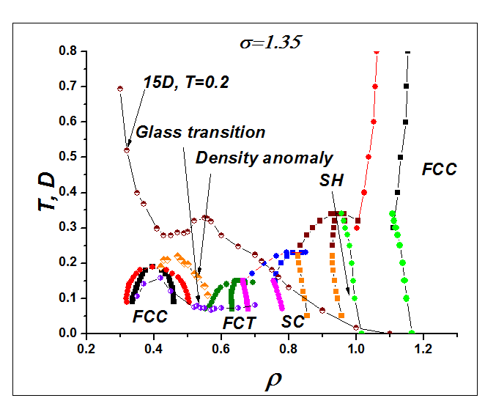
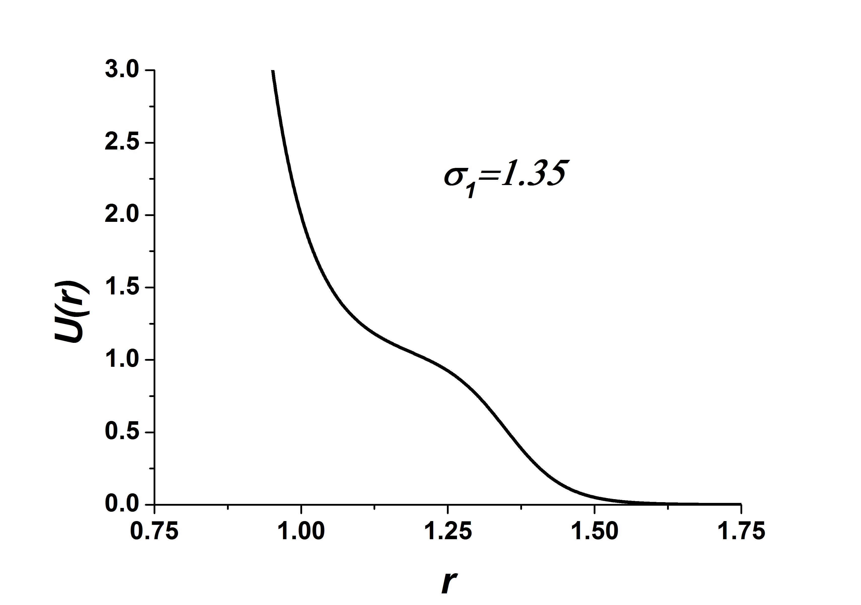

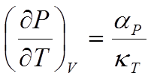

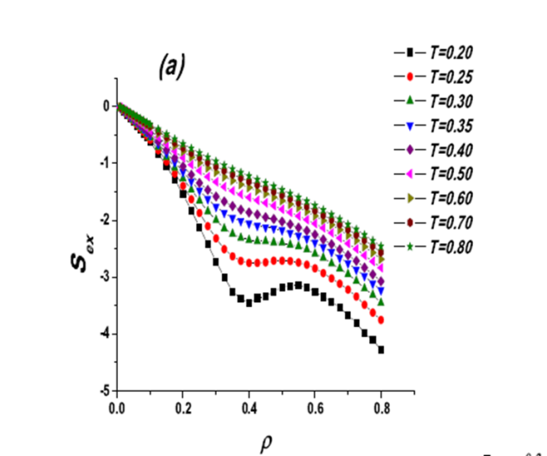
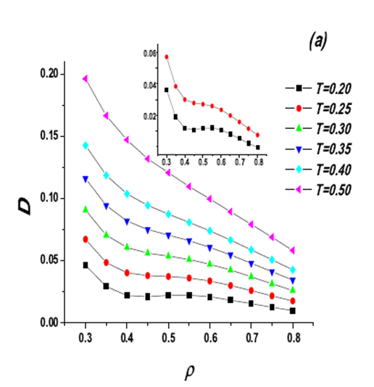
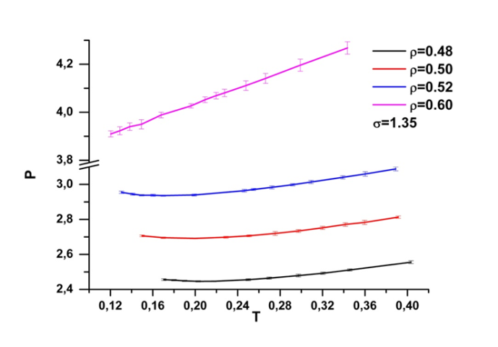
Phase diagrams and anomalies for SRSS (Yu. D. Fomin, N.V. Gribova, V.N.Ryzhov, S.M. Stishov, and Daan Frenkel, J. Chem. Phys. 129, 064512 (2008); Yu.D. Fomin, V.N. Ryzhov, and E.N. Tsiok, J. Chem. Phys. 134, 044523 (2011); Phys. Rev. E 87, 042122 (2013); R.E. Ryltsev, N.M. Chtchelkatchev, and V.N. Ryzhov, Phys. Rev. Lett. 110, 025701 (2013)).
Phase diagram for σ =1.35
(with diffusion and density
anomalies and glass
transition).

Slide 29
Melting scenarios in two-dimensions: Landau and BKTHNY theories
Order parameter
Landau expansion – first-order transition!
Fluctuations!
The Fourier coefficients vary slowly and have the amplitude and phase
where u(r) has the meaning of the displacement field in the crystal. In two dimensions,
the phase of the order parameter fluctuates most strongly

Slide 30
Melting scenarios in two-dimensions: Landau and BKTHNY theories
The Landau expansion of the free energy with the long-wavelength fluctuations of the order parameters:
V. N. Ryzhov et al, Phys. Rev. B 51, 8789 (1995); Physica A 314, 396-404 (2002);
Physica A 432 279–286 (2015) .
The first term in expansion is the free energy of a deformed solid
The singular part of the displacement field corresponds to dislocations and disclinations

Slide 31


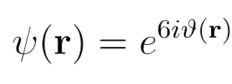


BKTHNY scenario of two-dimensional melting (M. Kosterlitz and D. J. Thouless, J. Phys. C 6,1181 (1973); D. R. Nelson and B. I. Halperin, Phys. Rev. B 19, 2457 (1979); A. P. Young, Phys. Rev. B 19, 1855 (1979)).
Translational and bond-orientational order in two-dimensional crystals
(N. D. Mermin, Phys. Rev. 176, 250 (1968))
Quasi-long range translational order
Is the BKTHNY scenario universal?
Long-range bond-orientational order!
Transition between a crystal and an isotropic liquid can occur by means of two continuous transitions
which correspond to dissociation of bound dislocation and disclination pairs, respectively.
Dislocations unbinding leads to a phase with short-range translational order,
but with quasi-long-range bond-orientational order - a hexatic phase.
No! First order transition is possible too.
Unbinding of disclination pairs via a continuous phase transition leads to isotropic liquid

Slide 32
Теория двумерного плавления Березинского-Костерлица-Таулеса-Хальперина-Нельсона-Янга (BKTHNY)
Уравнения ренормгруппы

Slide 33
Теория двумерного плавления Березинского-Костерлица-Таулеса-Хальперина-Нельсона-Янга (BKTHNY)
Экспериментальная проверка (Zahn, K., Lenke, R., and Maret, G., 1999,
Phys. Rev. Lett. 82, 2721; Zahn, K. and Maret, G., 2000, Phys. Rev. Lett. 85(17), 3656;
Zahn, K., Mndez-Alcaraz, J., and Maret, G., 1997, Phys. Rev. Lett. 79, 175;
Zanghellini,J.,Keim,P.,andvonGru ̈nberg,H.,2005,J.Phys.:Condens.Matter17,S3579;
Keim, P., Maret, G., Herz, U., and von Gru ̈nberg, H., 2004, Phys. Rev. Lett. 92, 215504)

Slide 34
Теория двумерного плавления Березинского-Костерлица-Таулеса-Хальперина-Нельсона-Янга (BKTHNY)
Экспериментальная проверка (корреляционные функции и модуль Юнга)
Теория KTHNY универсальна?

Slide 35
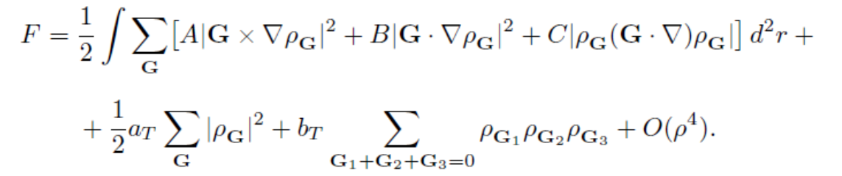
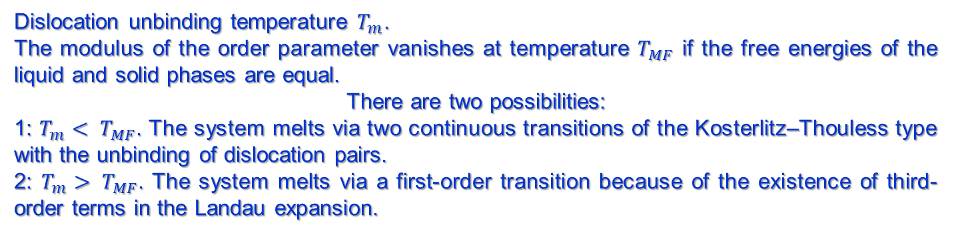
Melting scenarios in two-dimensions: Landau and BKTHNY theories
Dislocation unbinding temperature $T_{m}$.
The modulus of the order parameter vanishes at temperature $T_{MF}$ if the free energies of the liquid and solid phases are equal.
There are two possibilities:
1: $T_{m}< T_{MF}$. The system melts via two continuous transitions of the Kosterlitz–Thouless type with the unbinding of dislocation pairs.
2: $T_{m}> T_{MF}$. The system melts via a first-order transition because of the existence of third-order terms in the Landau expansion.
Possible scenarios: grain boundaries (S.T. Chui, Phys. Rev. Lett. 48, 933 (1982);
Phys. Rev. B 28, 178 (1983)); dissociation of disclination quadrupoles (V.N. Ryzhov,
Zh. Eksp. Theor. Phys. 100, 1627 (1991)), etc…

Slide 36
Melting scenarios in two-dimensions: First order versus continuous transition
There is no satisfactory answer yet for one of the most important questions in two-dimensional melting: what condition determines the existence of a hexatic phase and the nature of the melting transition?
Example: hard disk systems, where simulation results tend to favor a first-order transition scenario for melting, although some conflicting results also exist…
First-order transition without hexatic phase (J. Lee and K. J. Strandburg, Phys. Rev. B 46, 11190 (1992); H. Weber, D. Marx, and K. Binder, Phys. Rev. B 51, 14636 (1995); C. H. Mak, Phys. Rev. E 73, 065104 (2006)).
Continuous transition (A. Jaster, Phys. Rev. E 59, 2594 (1999); K. Binder, S. Sengupta, P. Nielaba, J. Phys.: Condens. Matter 14, 2323 (2002))
First-order transition isotropic liquid - hexatic phase (E. P. Bernard and W. Krauth, Phys. Rev. Lett. 107, 155704 (2011); M. Engel, J.A. Anderson, S.C. Glotzer, M. Isobe, E.P. Bernard, W. Krauth, Phys. Rev. E 87, 042134 (2013), W. Qi, A. P. Gantapara and M. Dijkstra, Soft Matter, 10, 5449 (2014).

Slide 37
Melting scenarios in two-dimensions: First order versus continuous transition
It seems that the softness of the repulsive part as well as the longer range of the attractive part of the interaction are important for the existence of a continuous phase transition in simple atomic systems (P. Bladon and D. Frenkel, Phys. Rev. Lett. 74, 2519 (1995); V.N. Ryzhov and E.E. Tareyeva, Phys. Rev. B 51, 8789 (1995); V. N. Ryzhov and E. E. Tareyeva, Physica A 314, 396 (2002); S.I. Lee and S.J. Lee, Phys. Rev. E 78, 041504 (2008); S. Prestipino, F. Saija, and P.V. Giaquinta, PRL 106, 235701 (2011); S. Prestipino, F. Saija, and P.V. Giaquinta, J. Chem. Phys.137, 104503 (2012); D.E. Dudalov, Yu.D. Fomin, E.N. Tsiok, and V.N. Ryzhov, Journal of Physics: Conference Series 510, 012016 (2014); Soft Matter 10, 4966 (2014); J. Chem. Phys. 141, 18C522 (2014)).
The BKTNHY scenario was unambiguously experimentally confirmed for superparamagnetic colloidal particles interacting via long-range dipolar interaction scaling with the inverse cube of particles separation (K. Zahn and G. Maret, Phys. Rev. Lett. 85, 3656 (2000); H. H. von Grunberg, P. Keim, K. Zahn, and G.Maret, Phys. Rev. Lett. 93, 255703 (2004); P. Keim, G. Maret, and H. H. von Grunberg, Phys. Rev. E 75, 031402 (2007).).

Slide 38

Melting scenarios in two-dimensions: First order versus continuous transition
First-order liquid-hexatic and continuous hexatic-solid transition (E.P. Bernard and W. Krauth, Phys. Rev. Lett. 107, 155704 (2011); M. Engel, J.A. Anderson, S.C. Glotzer, M. Isobe, E.P. Bernard, W. Krauth, Phys. Rev. E 87, 042134 (2013), W. Qi, A. P. Gantapara and M. Dijkstra, Soft Matter, 10, 5449 (2014); S.C. Kapfer and W. Krauth, Phys. Rev. Lett. 114, 035702 (2015); A.H. Marcus and S. A. Rice, Phys. Rev. Lett. 77, 2577 (1996); Phys. Rev. E 55, 637 (1997); W.K. Qi, S.M. Qin, X.Y. Zhao, and Yong Chen, J. Phys.: Condens. Matter 20 (2008) 245102; W. Qi and M. Dijkstra, Soft Matter DOI: 10.1039/c4sm02876g).

Slide 39

Melting scenarios in two-dimensions: Landau and BKTHNY theories of liquid-hexatic transition
Order parameter
Mean-field expansion – transition at $T_{MF}$
Fluctuations of the order parameter phase in 2D
BKT liquid-hexatic transition
Unbinding of the singular topological defects of the order-parameter phase
(disclinations) at $T_{i}$ - BKT transition. Continuous transition at $T_{i}$ and at $T_{MF}$.
What is the mechanism of the first-order liquid-hexatic transition (grain-boundaries like mechanism)?

Slide 40
Melting scenarios in two-dimensions: First order versus continuous transition: Question: How can we distinguish the first-order and continuous transitions in simulations?
K. Binder, S. Sengupta, P. Nielaba, J. Phys.: Condens. Matter 14, 2323 (2002))
1. Isotherms
Qualitative view of the isotherms according to the BKTNY theory (left)
and for the case of the first-order transition (right)

Slide 41
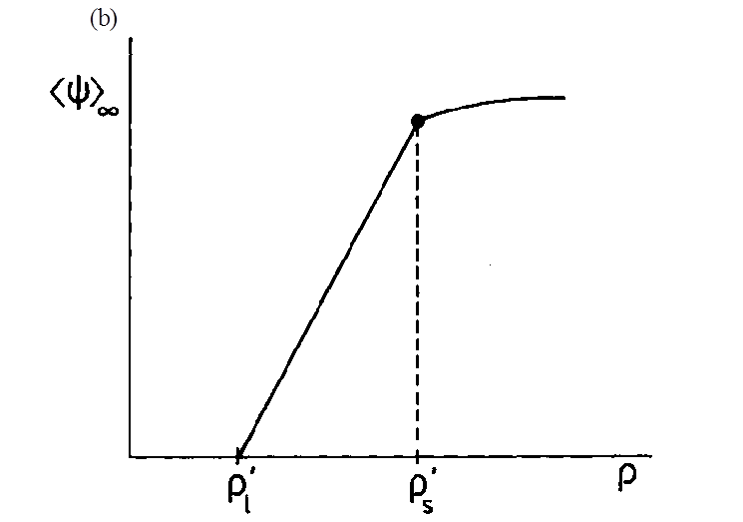

Melting scenarios in two-dimensions: First order versus continuous transition
2. A schematic diagram of the variation
of the bond-orientational order parameter
expected in the case of the first-order transition
3.The schematic behaviors of the logarithms of the bond-order correlation function (blue)
and the translational correlation function (purple).
triangular crystal
hexatic phase
isotropic liquid

Slide 42
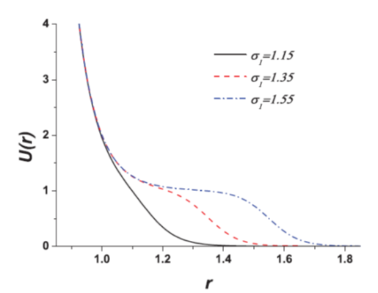
Phase diagram of the 2D core-softened system – effect of the potential softness(D.E. Dudalov, Yu.D. Fomin, E.N. Tsiok, and V.N. Ryzhov, Journal of Physics: Conference Series 510, 012016 (2014); Soft Matter 10, 4966 (2014); J. Chem. Phys.141,18C522 (2014)).
Helmholtz free energy calculations for different phases and a common tangent to them (D. Frenkel and B. Smit, Understanding Molecular Simulation (Academic, New York, 2002))

Slide 43
Melting transition in core-softened system - effect of the potential softness
Low temperature isotherms for σ=1.35 and σ=1.55 - 2 continuous and first-order transitions
High temperature isotherms –
- liquid-solid first order transition

Slide 44


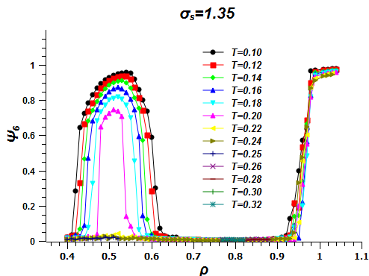
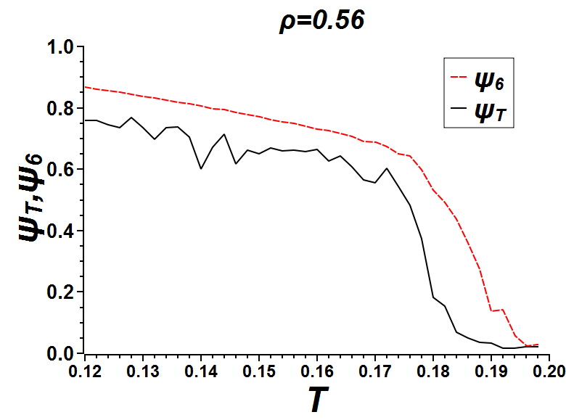
Melting transition in core-softened system
Bond orientational order parameter as a function of density –continuous transition at low densities and first-order transition at high densities
The translational and orientational order
parameters as functions of temperature.

Slide 45
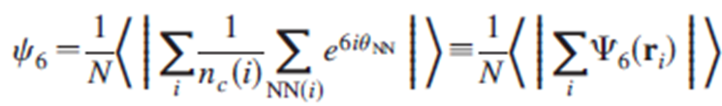

Melting transition in core-softened system – orientational and translational order parameters and correlation functions
n=6,T
Orientational correlation function at selected temperature. For σ=1.35 and σ=1.55 upon increasing ρ there is a qualitative change in the long-range behavior from constant (triangular solid) to power-law decay (hexatic), up to exponential decay (isotropic liquid). The decay exponent η <1/4.
Low temperatures and densities

Slide 46
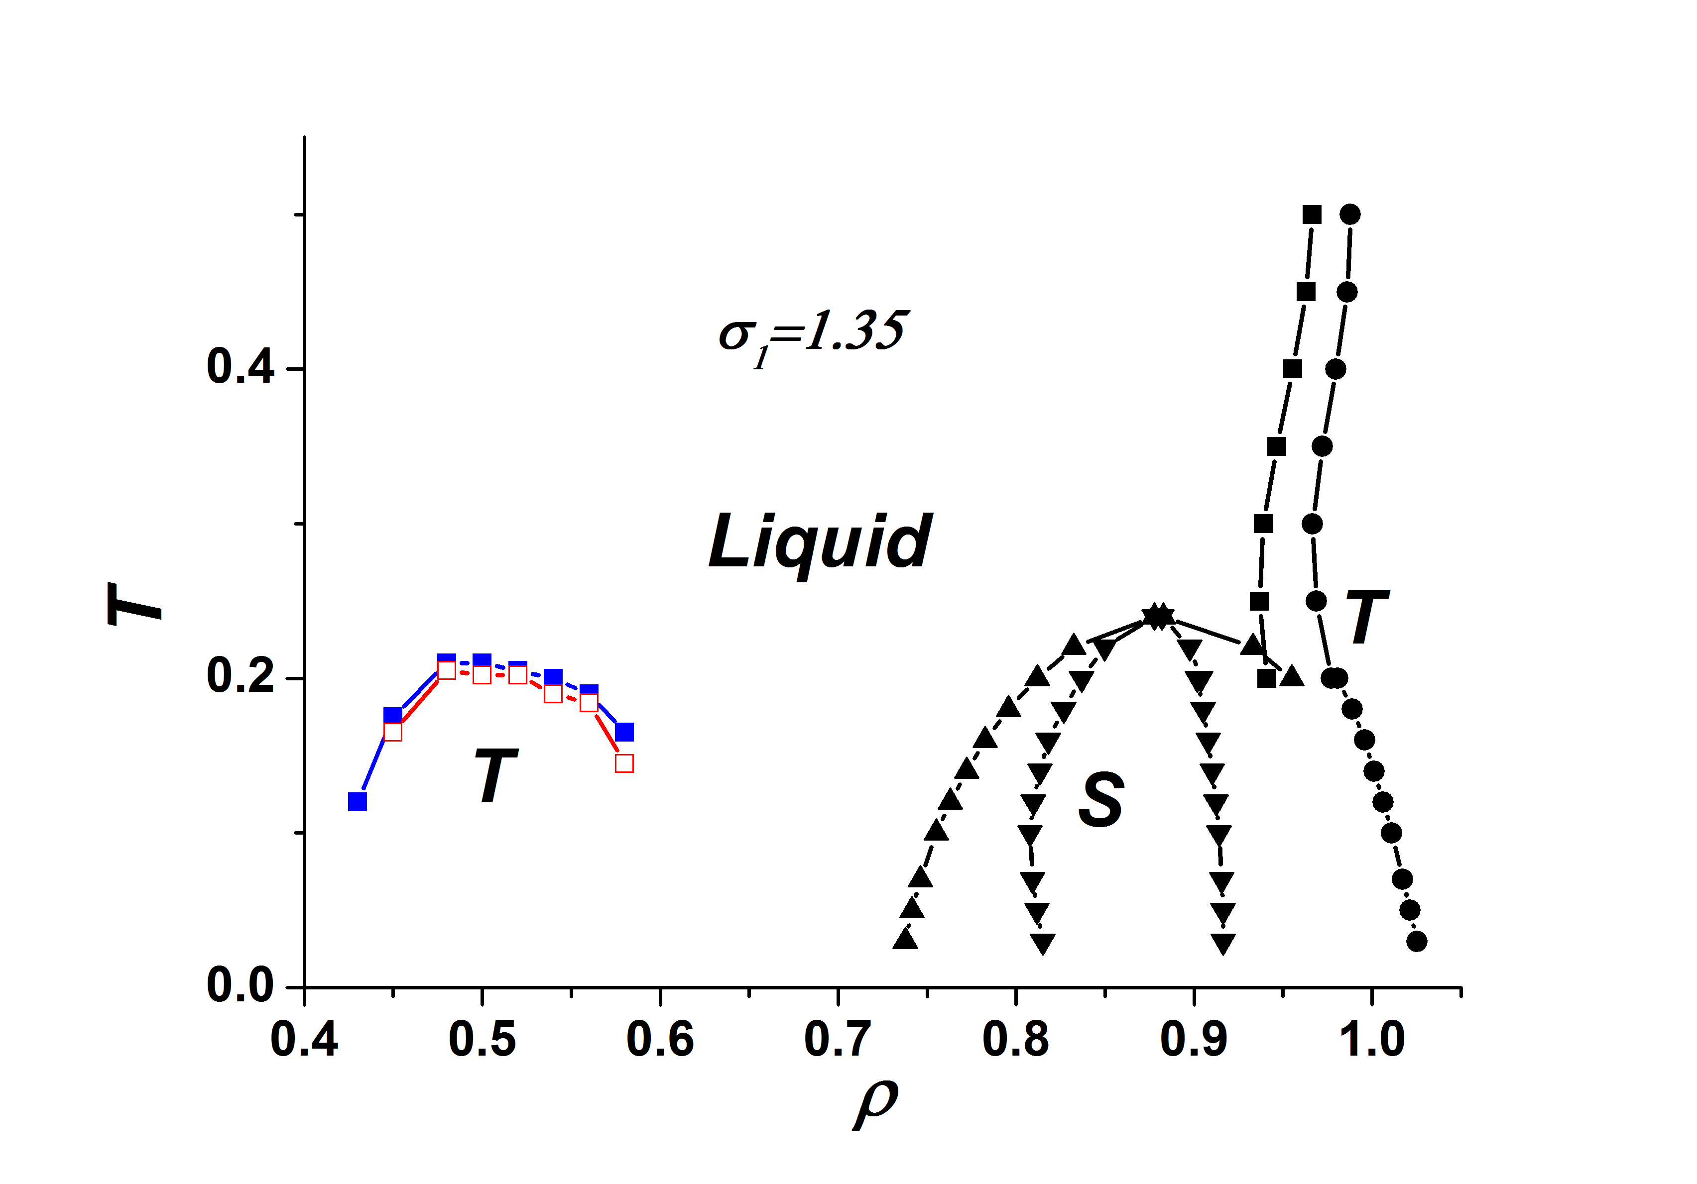
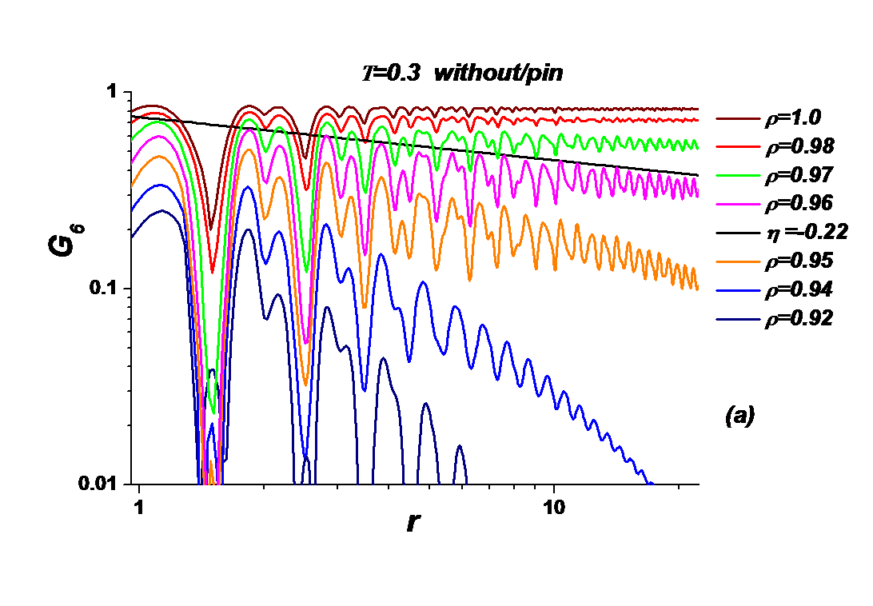
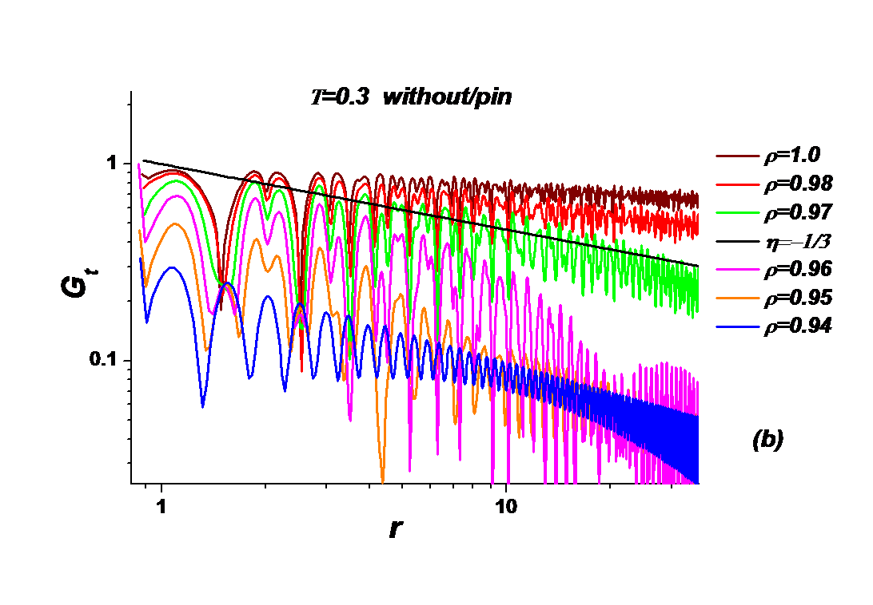
Melting transition in core-softened system – orientational and translational order parameters and correlation functions
High temperatures and densities σ=1.35

Slide 47
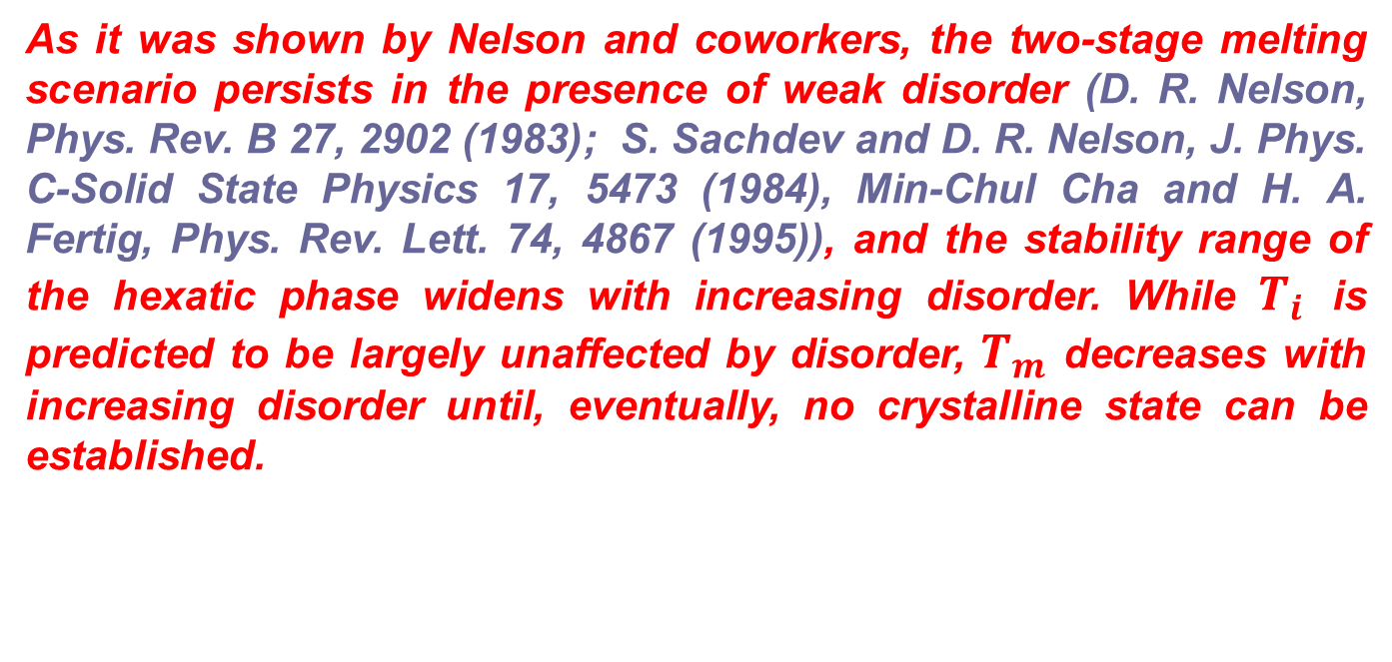
Influence of random pinning on the phase diagram of core-softened system
In experiment planar confinement is typically realized by adsorption on an interface, such that crystallization usually occurs on solid substrates which introduce quenched (i.e., frozen-in) disorder due to some roughness.
As it was shown by Nelson and coworkers, the two-stage melting scenario persists in the presence of weak disorder (D. R. Nelson, Phys. Rev. B 27, 2902 (1983); S. Sachdev and D. R. Nelson, J. Phys. C-Solid State Physics 17, 5473 (1984), Min-Chul Cha and H. A. Fertig, Phys. Rev. Lett. 74, 4867 (1995)), and the stability range of the hexatic phase widens with increasing disorder. While $T_{i}$ is predicted to be largely unaffected by disorder, $T_{m}$ decreases with increasing disorder until, eventually, no crystalline state can be established.

Slide 48
Two-Dimensional Melting under Quenched Disorder (experiment) (S. Deutschlander, T. Horn, H. Lowen, G. Maret, and P. Keim, Phys. Rev. Lett. 111, 098301 (2013);T. Horn, S. Deutschlander, H. Lowen, G. Maret, and P. Keim, Phys. Rev. E 88, 062305 (2013)).

Slide 49
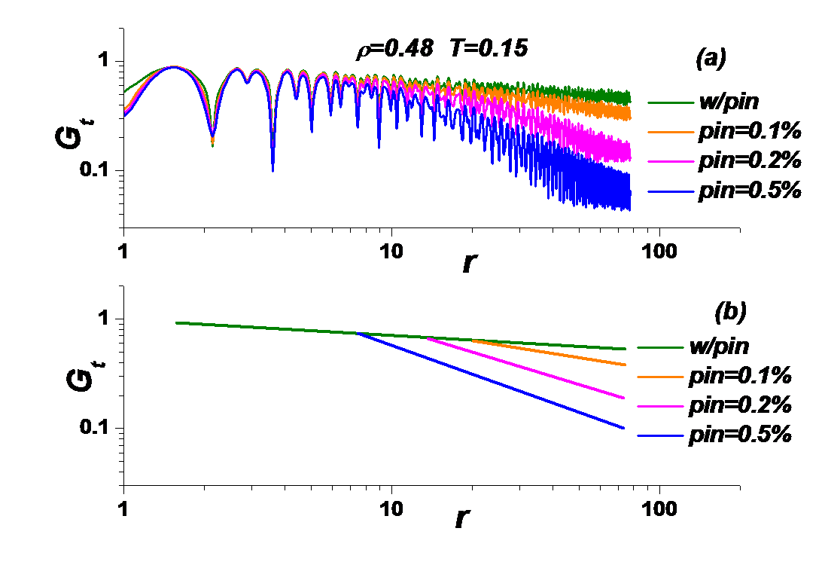
Dependence of translational correlation functions on the random pinning concentrations (E. N. Tsiok, D.E. Dudalov, Yu. D. Fomin, and V. N. Ryzhov, arXiv: 1507.01802 (Phys. Rev. E, in press)).

Slide 50
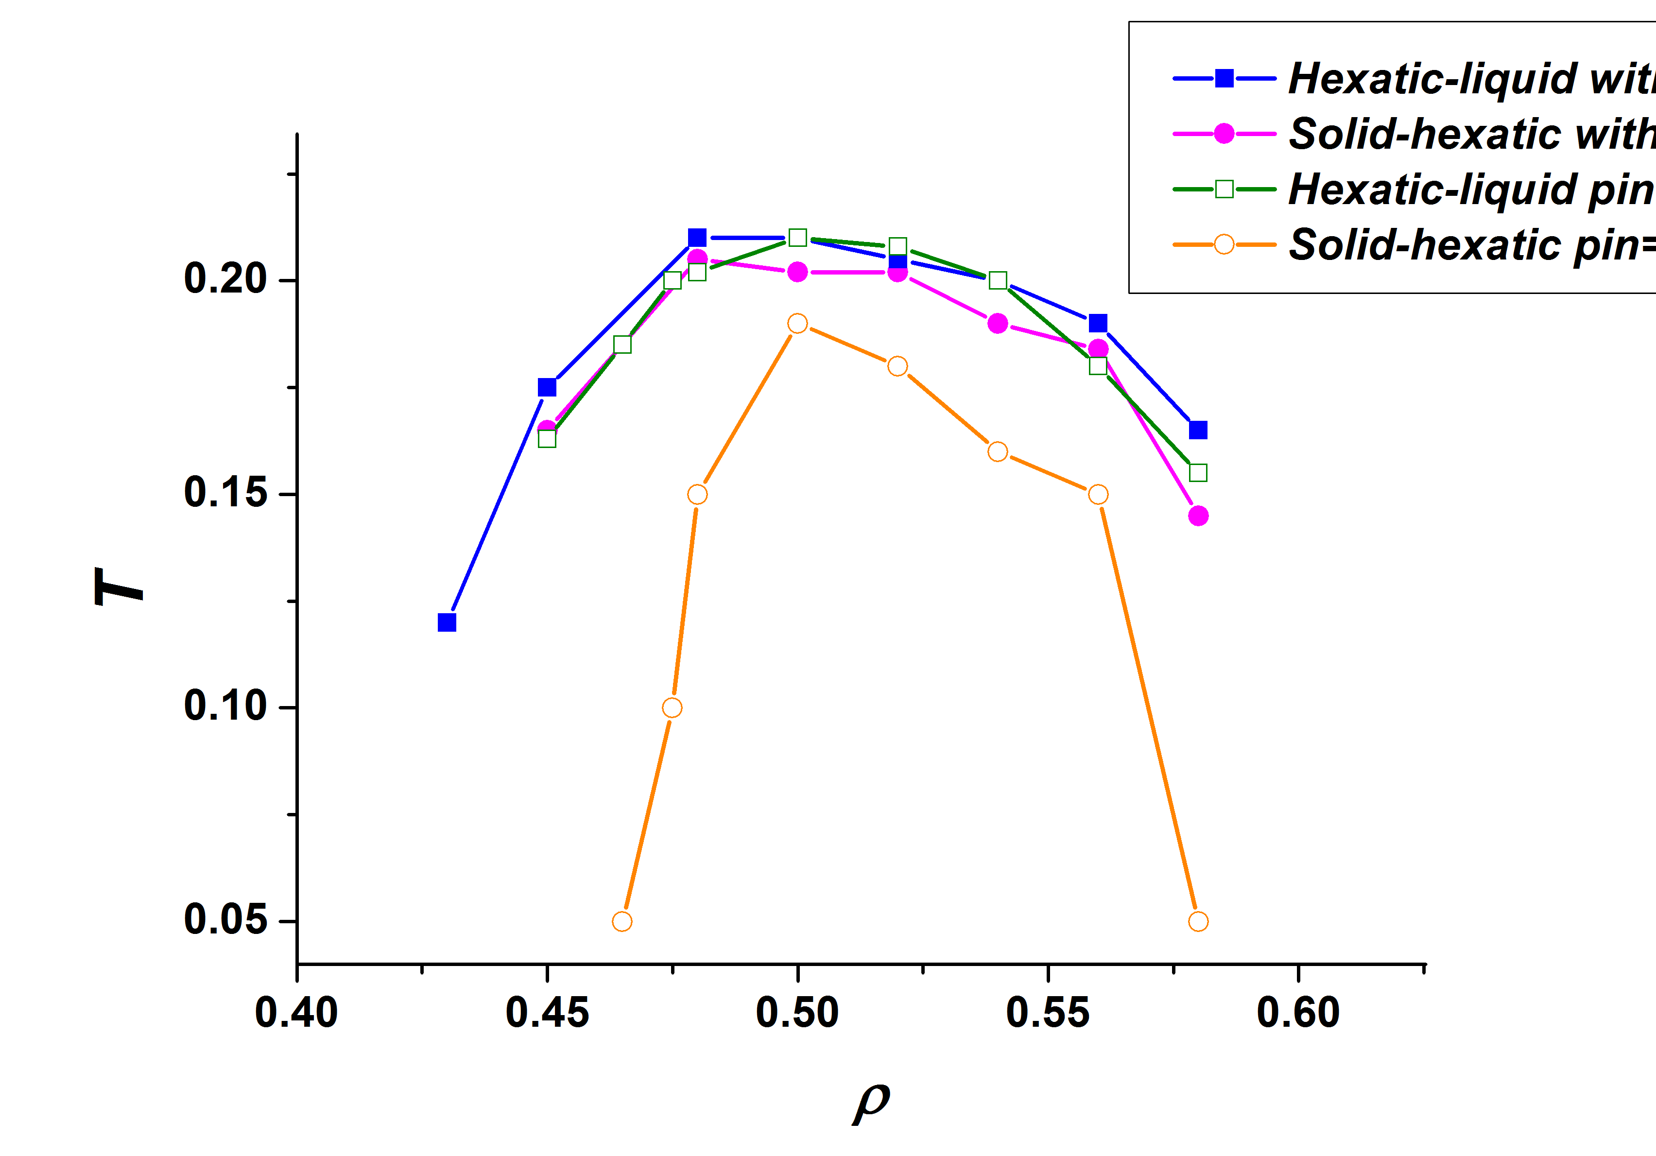
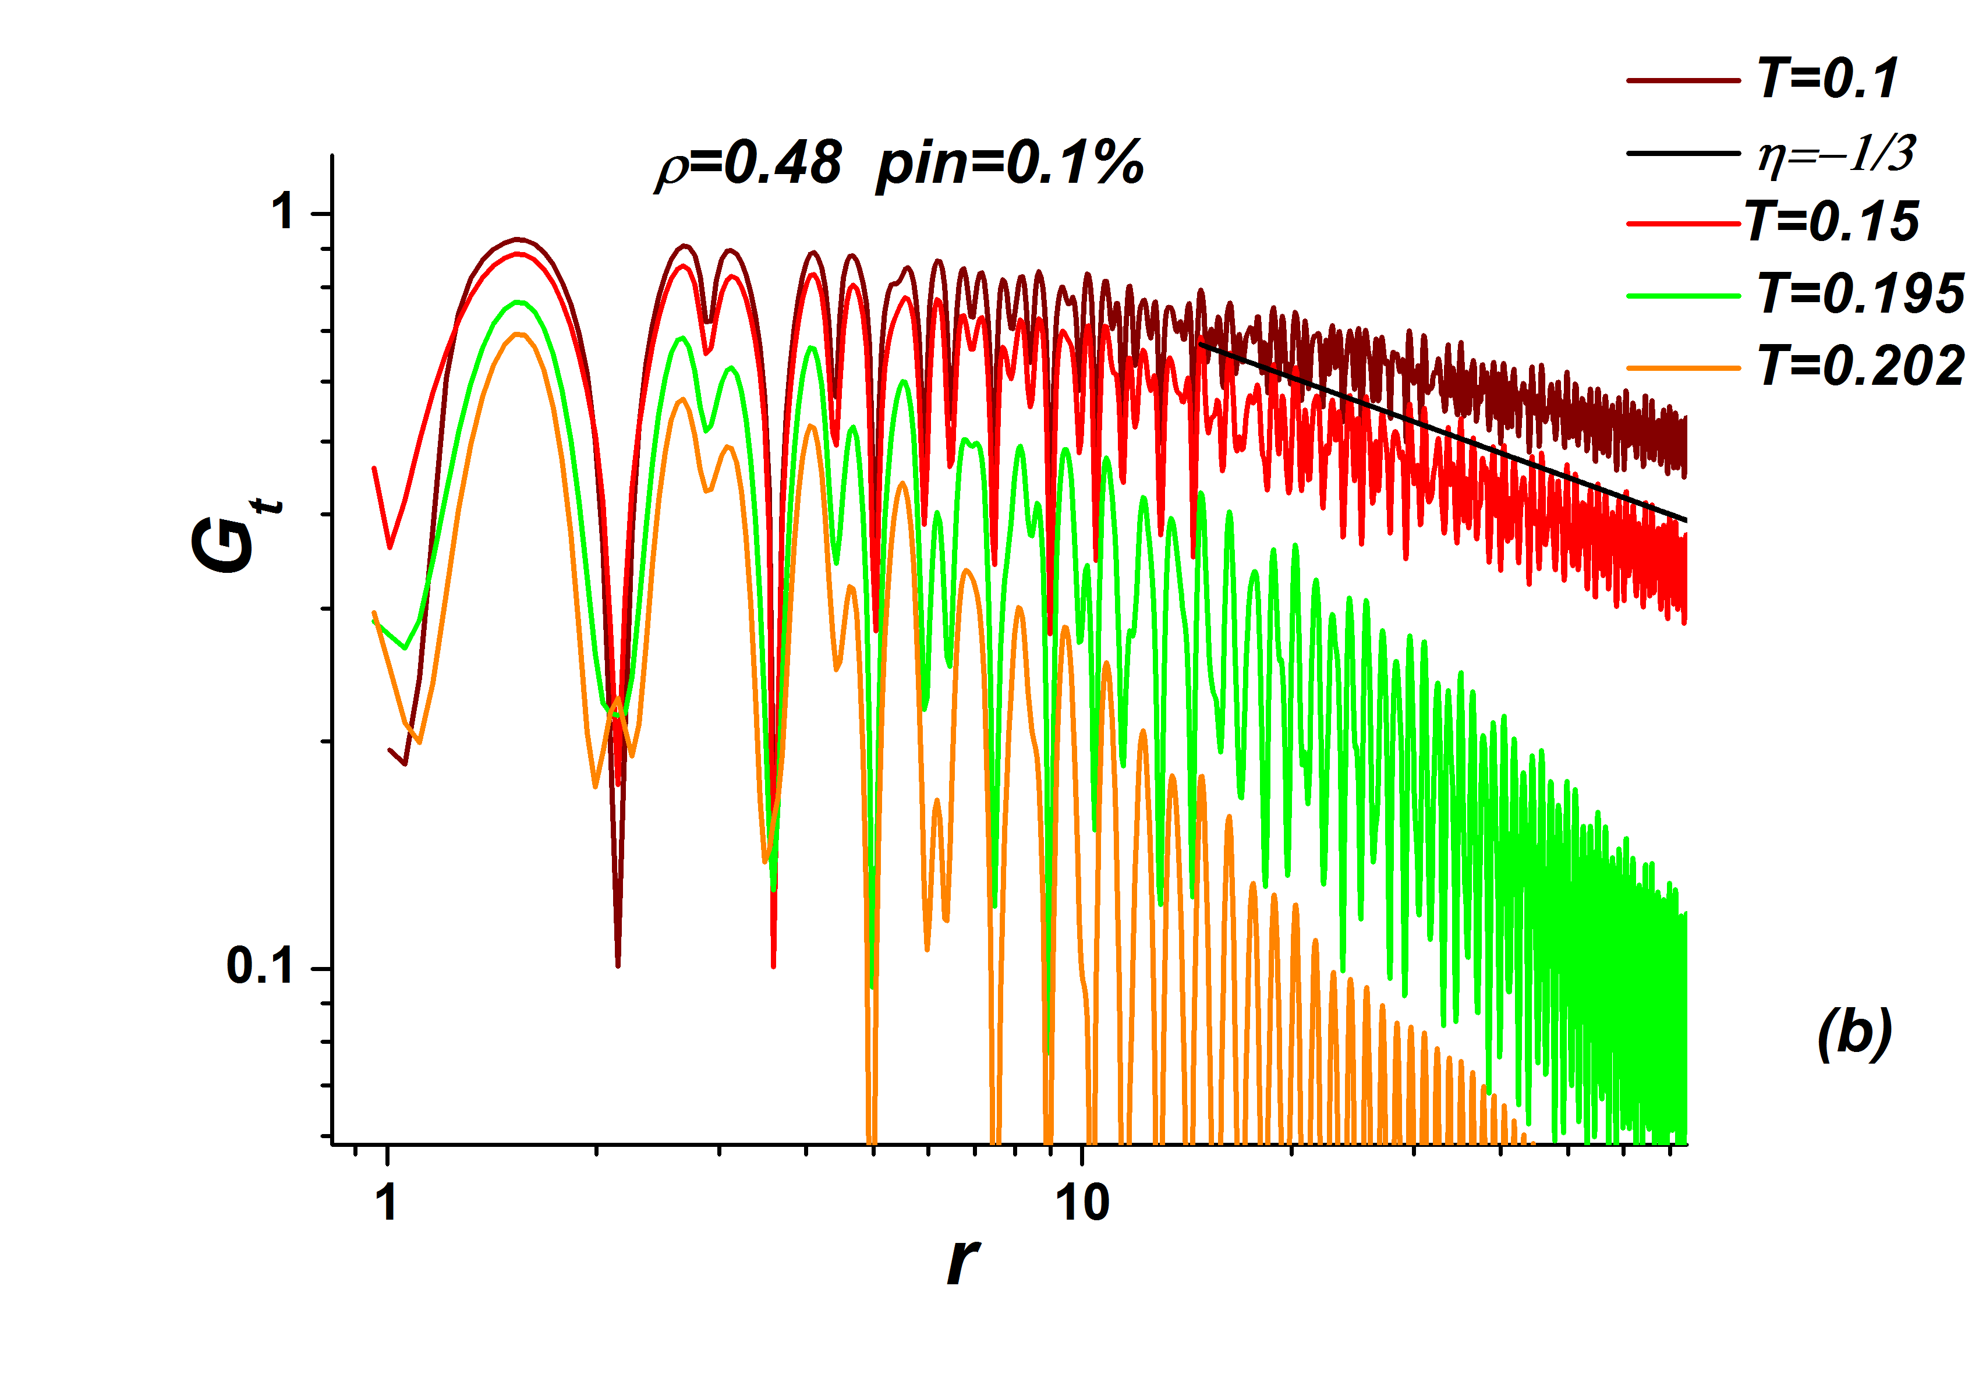
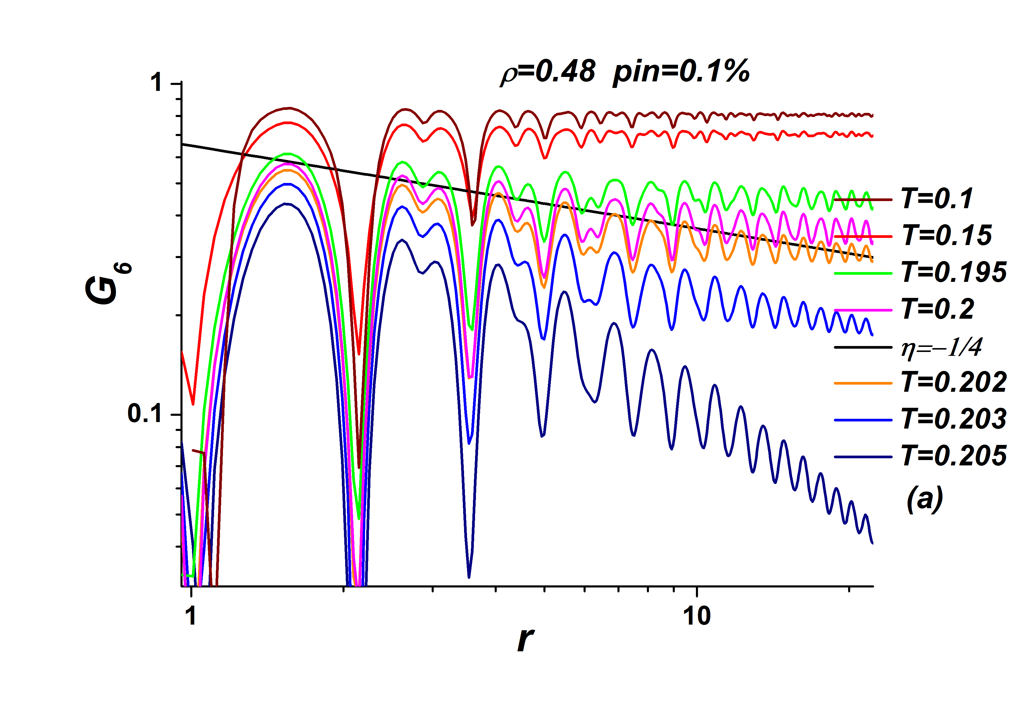
Orientational and translational correlation functions at low densities and low-density phase diagram

Slide 51
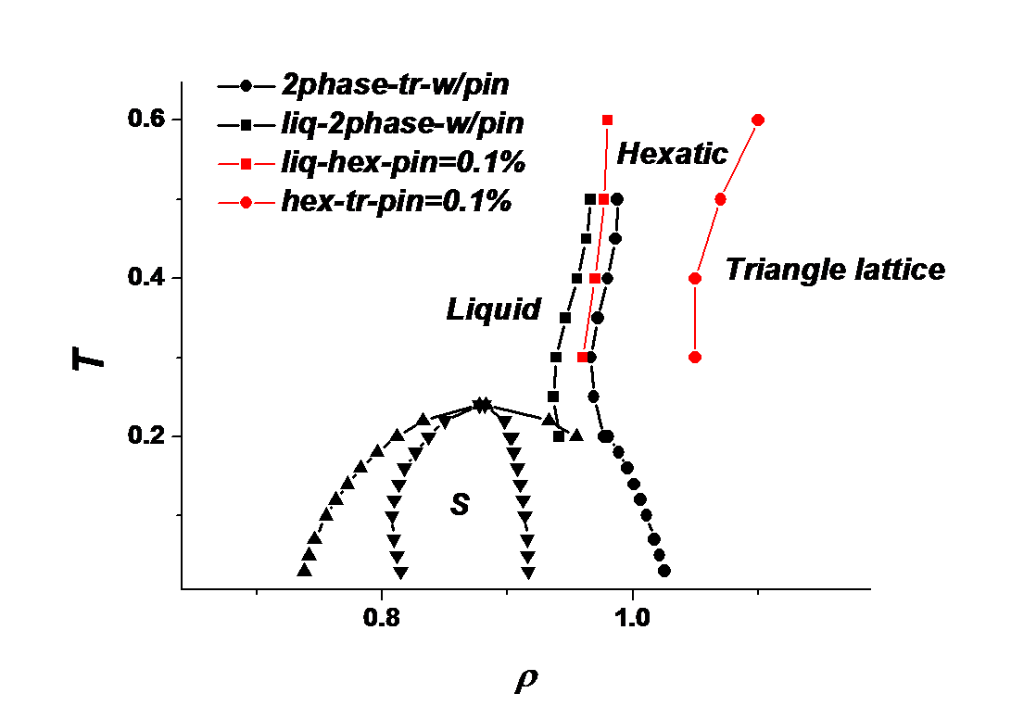
Phase diagram in the presence of pinning – high densities

Slide 52
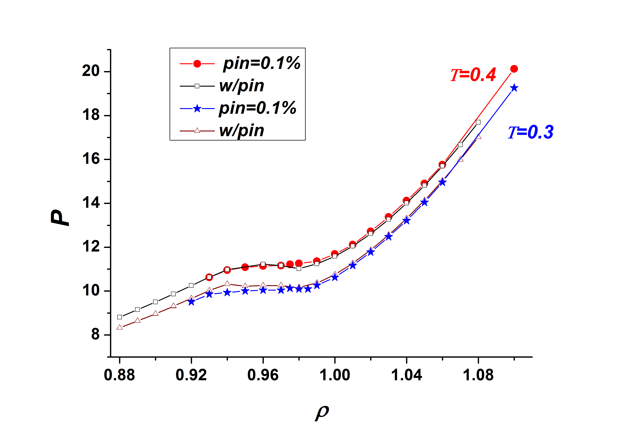
Influence of random pinning on the phase diagram of core-softened system – equation of state (σ=1.35 )
N=20000; concentration of pinning centers=0.1%
First-order liquid-hexatic transition?

Slide 53
Conclusions
1). The density profile of a liquid in a cylinder or in slit pores is stratified. For a given separation of the confining walls the density amplitude is greatest adjacent to the wall and decays to the bulk density on the scale of a few molecular diameters.
2). At sufficiently high density the fluid in a confined domain freezes into an ordered solid, the structure of which depends on the interplay between the particle-particle excluded volume and the particle‐wall interaction. A confined system can support phases that do not exist in 3D, e.g. the hexatic phase in 2D.
3). The properties of nanoconfined water are very strongly dependent on both the nanotube diameter and the structure of the confining wall. It is not possible to consider the confined water as a system independent of the character of the confining walls.
4). At low temperature and/or high pressure the water enclosed in nanopores forms a variety of ordered structures; these ices have structures that depend on hydrogen bonding, wall curvature and molecule wall interactions.

Slide 54
Conclusions
5). In the talk we present a molecular dynamics study of the two dimensional core-softened system. As in the analogous three dimensional case, a reentrant-melting transition occurs upon compression for not too high pressures, along with a spectrum of water-like anomalies in the fluid phase.
6). For large values of repulsive shoulder, in the low density part of the phase diagram, melting is a continuous two-stage transition, with an intermediate hexatic phase. All available evidence supports the Kosterlitz-Thouless-Halperin-Nelson-Young scenario. At high density part of the phase diagram one first-order transition takes place.
7). For small values of repulsive shoulder transition is of first order.
8). The influence of the random pinning on the phase diagram is investigated. It is shown that at low densities, where melting occurs through two continuous transition, pinning widens the range of the hexatic phase. At high densities random pinning transforms the first order melting in two transitions: first-order liquid-hexatic transition and continuous hexatic-solid transition.

Slide 55
Conclusions
9). In general, the character of the melting transition in quasi 2D confinement depends on the particle‐particle interaction, unlike the universal first order character of the melting transition in 3D, which is independent of the particle‐particle interaction. When the particle‐particle interaction is long‐ranged, such as dipole‐dipole repulsion, the 2D melting process is well described by the KTHNY theory. In particular, the transitions between the solid and the hexatic phase and the hexatic and the liquid phase are continuous. When the particle‐particle interaction is short‐ranged, such as hard‐core repulsion, the character of the melting process is not yet resolved. Overall, for the case of 2D melting, the current evidence supports the existence of a hexatic phase intermediate between the liquid and ordered solid phases, but whether the liquid‐to‐hexatic phase transition is continuous or weakly first order is not fully understood.

Slide 56
Thank you very much for your attention

Slide 57
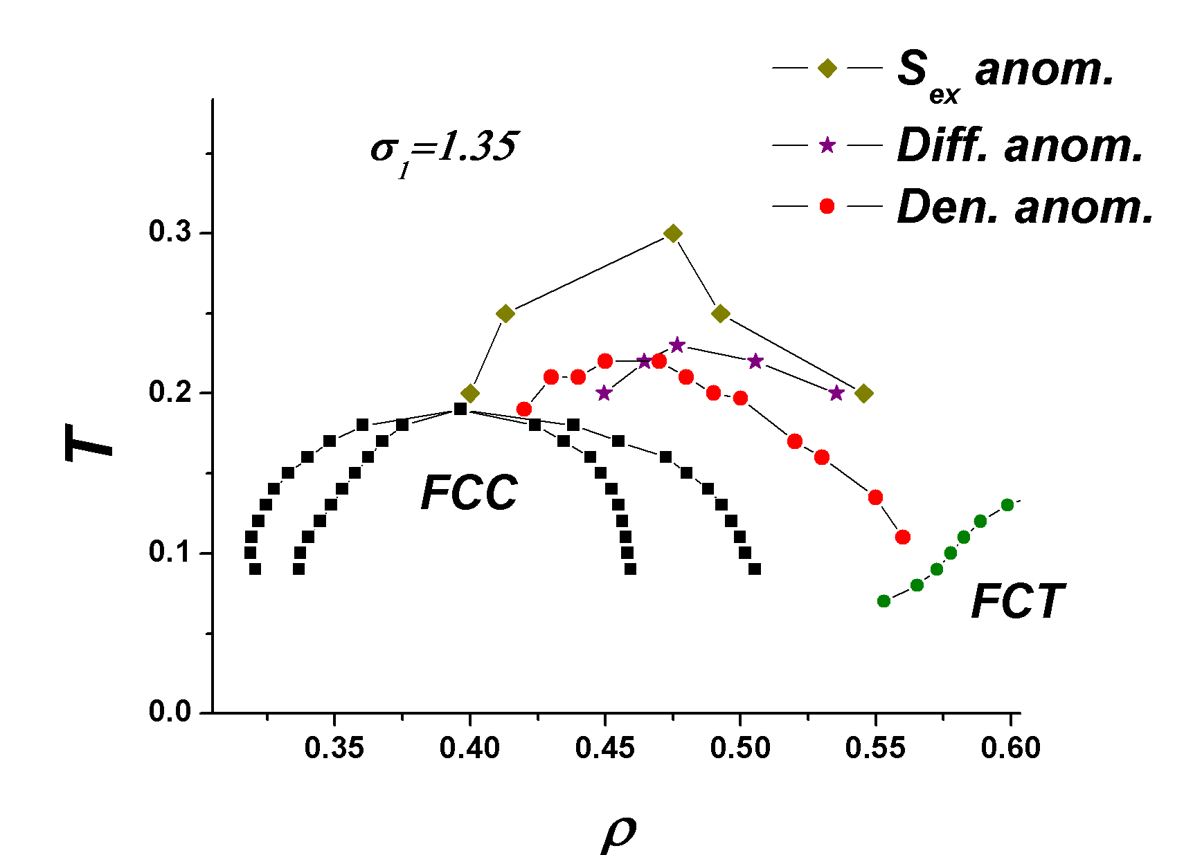
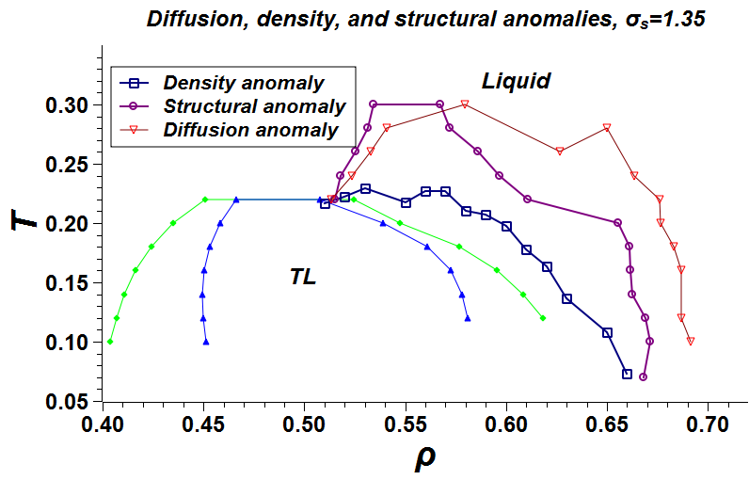
Anomalous behavior of the core-softened system in 2D: sequence of anomalies in core-softened systems
2D (Inversion of sequence of diffusion
and structural anomalies in core-softened systems D.E. Dudalov, Yu.D. Fomin, E.N. Tsiok, and V.N. Ryzhov, Soft Matter 10, 4966 (2014)))
3D (Yu. D. Fomin, E. N. Tsiok, and V. N. Ryzhov, J. Chem. Phys. 135, 234502 (2011); Yu. D. Fomin, E. N. Tsiok, and V. N. Ryzhov,
Phys. Rev. E 87, 042122 (2013))
Is this behavior universal for models of water-like
anomalies?
May be, no!
Waterlike sequence of anomalies
(J.R. Errington, P.D. Debenedetti,
Nature (London) 409 (2001) 318)
Silicalike sequence of anomalies (S. Shell, P.G. Debenedetti, and A.Z. Panagiotopoulos, Phys. Rev. E 66, 011202 (2002); Yu. D. Fomin, E. N. Tsiok, and V. N. Ryzhov, Phys. Rev. E 87, 042122 (2013))

